Slide 1
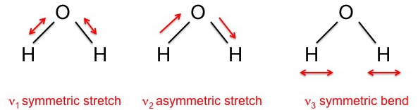
Let’s do a full analysis of water …
Write down C_{V} in the low-temperature limit
Write down C_{V} in the high-temperature limit
Putting T* at about the middle of your x-axis, sketch U(T) and C_{V} (T)

Slide 2
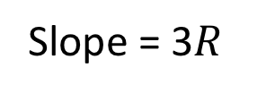
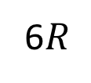
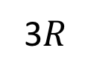
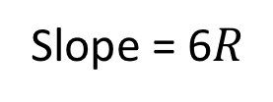
Let’s do a full analysis of water …
Write down C_{V} in the low-temperature limit
Write down C_{V} in the high-temperature limit
Putting T* at about the middle of your x-axis, sketch U(T) and C_{V} (T)
Slope = 6$R$
U(T)
Slope = 3$R$
C_{V}(T)
6$R$
3$R$
T*
T

Slide 3
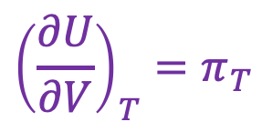
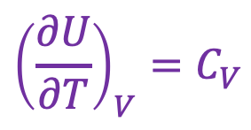
Back to U as a thermodynamic surface: there’s another slope too!
$${\left(\frac{∂U}{∂V}\right)}_{T}=π_{T}$$
U(T,V)
$${\left(\frac{∂U}{∂T}\right)}_{V}=C_{V}$$
V
“State Space”
T

Slide 4
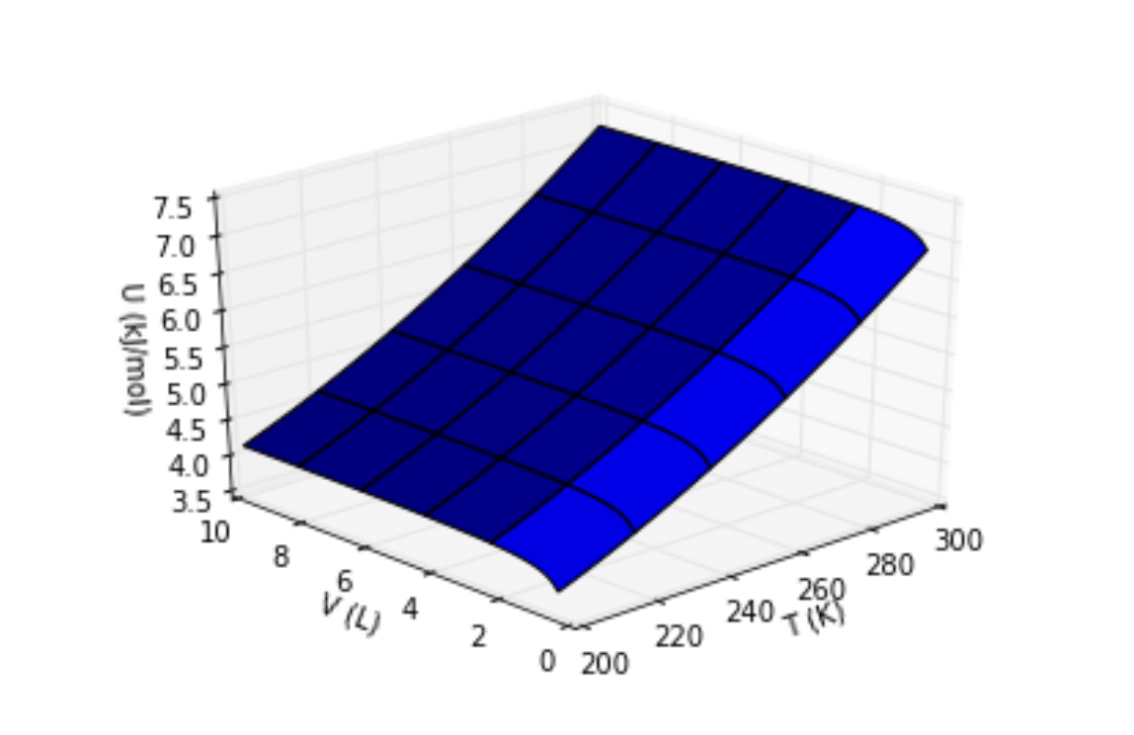


A more realistic depiction of $U(T,V)$
$$π_{T}$$
$$C_{V}$$
Isochoric heating experiment
Isothermal expansion experiment

Slide 5
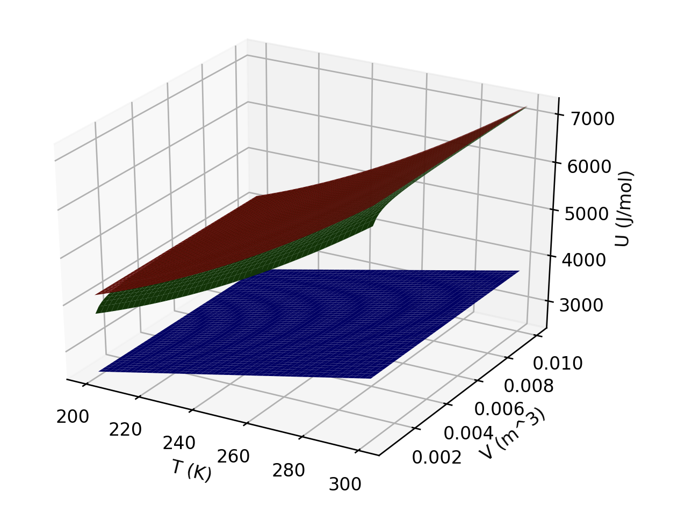
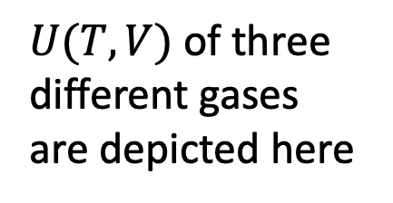
Visualizing 𝑼(𝑻,𝑽)
$U(T,V)$of three different gases are depicted here

Slide 6
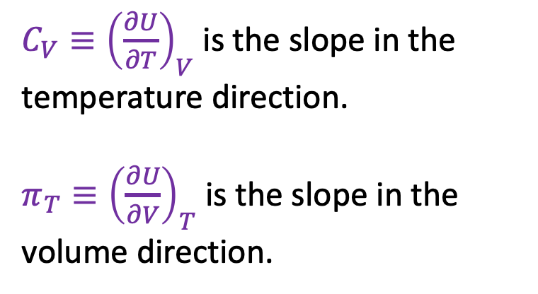
Interpreting U(T,V)
${C_{V}≡\left(\frac{∂U}{∂T}\right)}_{V}$ is the slope in the temperature direction.
$π_{T}≡{\left(\frac{∂U}{∂V}\right)}_{T}$ is the slope in the volume direction.

Slide 7
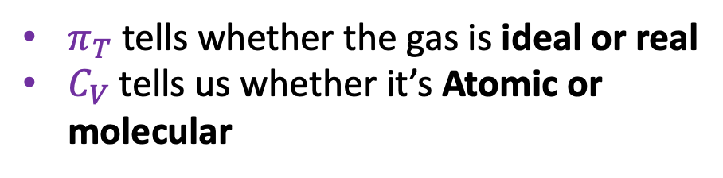
Interpreting U(T,V)
$π_{T}$ tells whether the gas is ideal or real
$C_{V}$tells us whether it’s Atomic or molecular

Slide 8
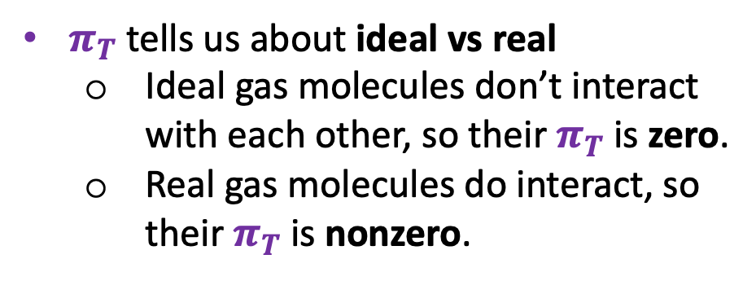
Interpreting U(T,V)
$π_{T}$ tells us about ideal vs real
Ideal gas molecules don’t interact with each other, so their $π_{T}$ is zero.
Real gas molecules do interact, so their $π_{T}$ is nonzero.

Slide 9
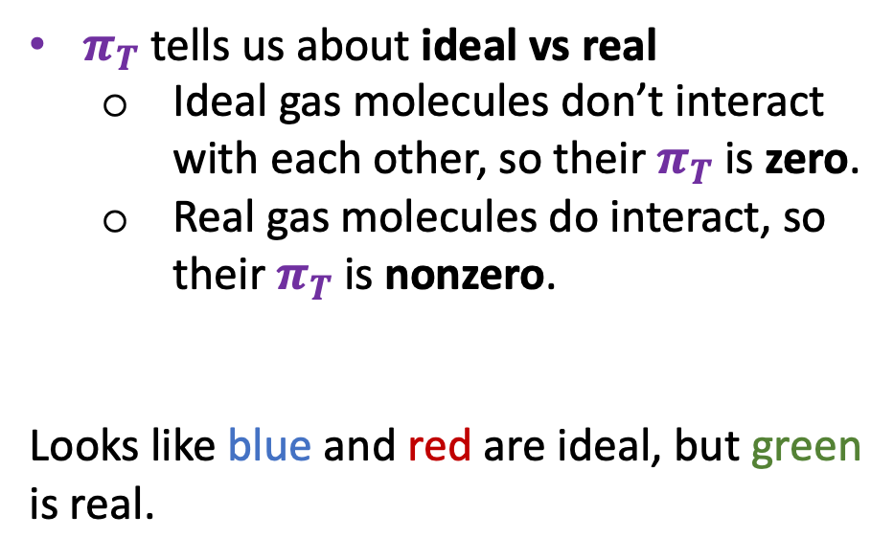
Interpreting U(T,V)
$π_{T}$ tells us about ideal vs real
Ideal gas molecules don’t interact with each other, so their $π_{T}$ is zero.
Real gas molecules do interact, so their $π_{T}$ is nonzero.
Looks like blue and red are ideal, but green is real.

Slide 10
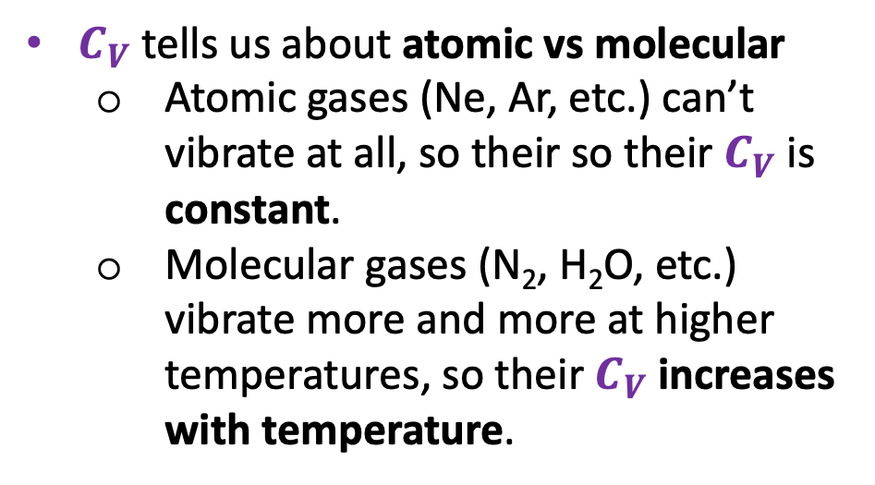
Interpreting U(T,V)
$C_{V}$ tells us about atomic vs molecular
Atomic gases (Ne, Ar, etc.) can’t vibrate at all, so their so their $C_{V}$ is constant.
Molecular gases (N₂, H₂O, etc.) vibrate more and more at higher temperatures, so their $C_{V}$ increases with temperature.

Slide 11
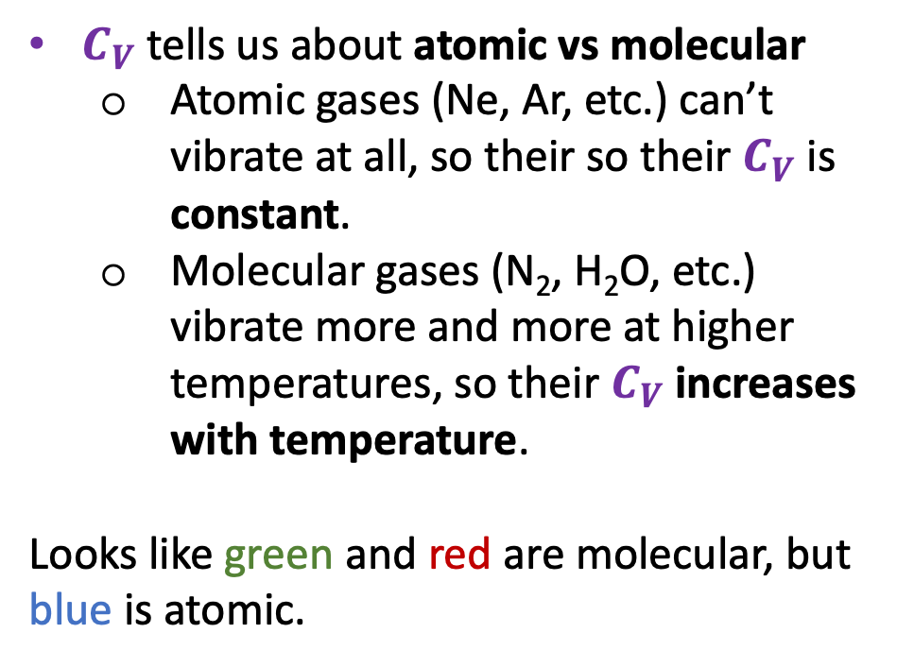
Interpreting U(T,V)
$C_{V}$ tells us about atomic vs molecular
Atomic gases (Ne, Ar, etc.) can’t vibrate at all, so their so their $C_{V}$ is constant.
Molecular gases (N₂, H₂O, etc.) vibrate more and more at higher temperatures, so their $C_{V}$ increases with temperature.
Looks like green and red are molecular, but blue is atomic.

Slide 12
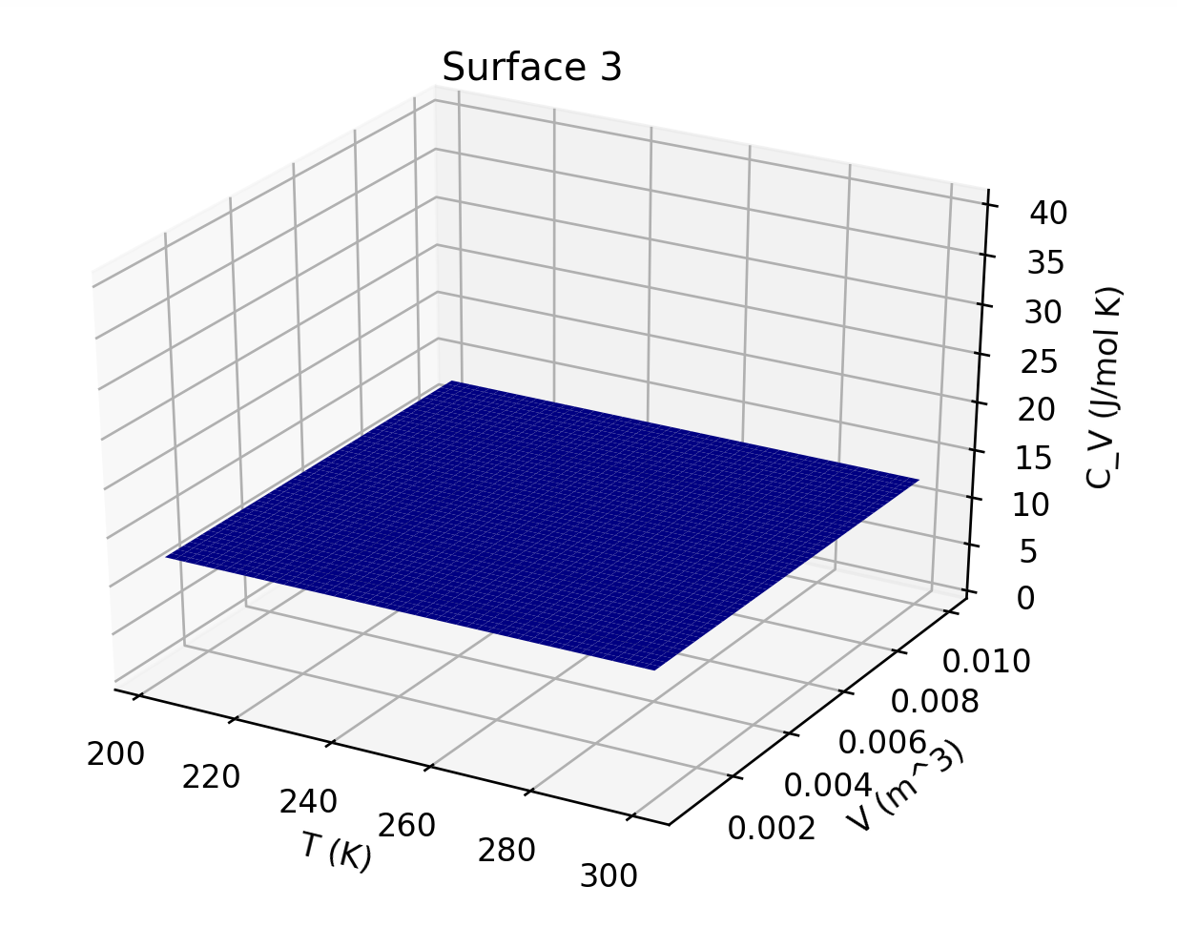
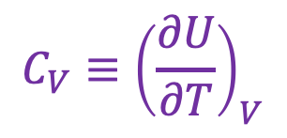

Interpreting U(T,V)
$${C_{V}≡\left(\frac{∂U}{∂T}\right)}_{V}$$
Here’s $CV(T,V)$ for the blue surface

Slide 13
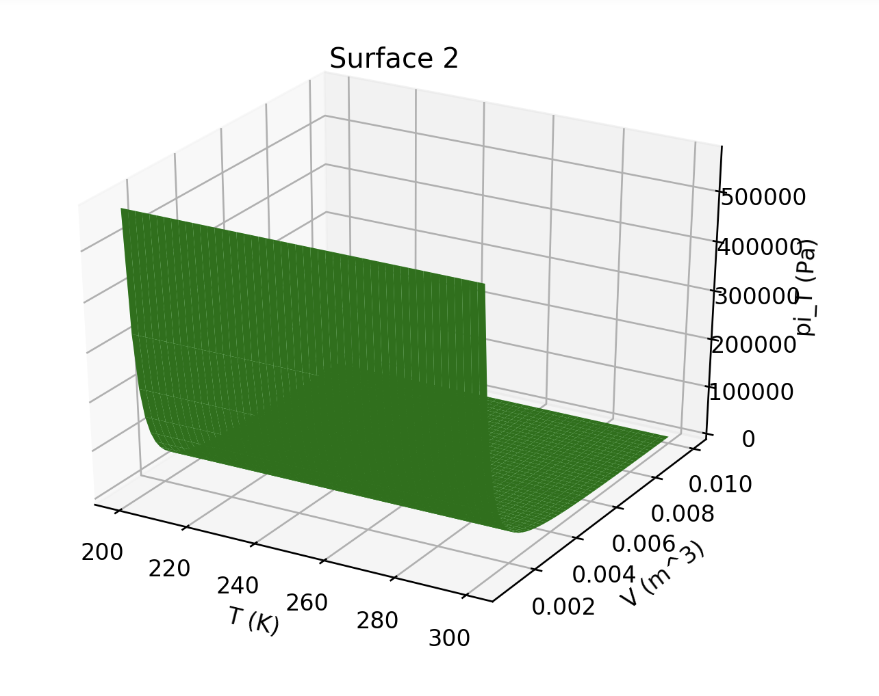
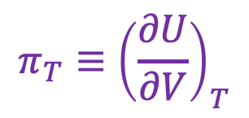

Interpreting U(T,V)
$$π_{T}≡{\left(\frac{∂U}{∂V}\right)}_{T}$$
Here’s $πV(T,V)$ for the green surface

Slide 14
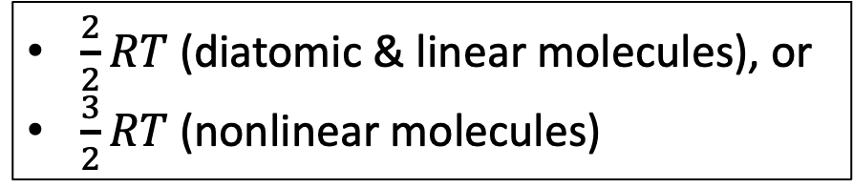
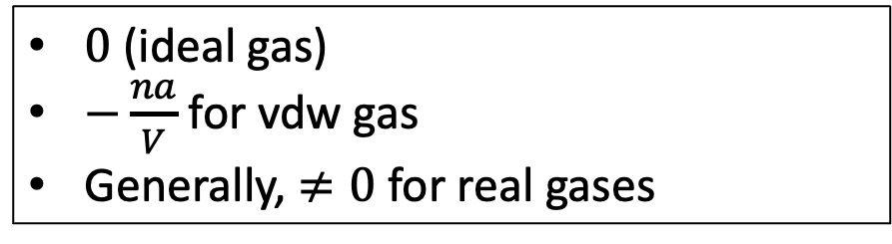
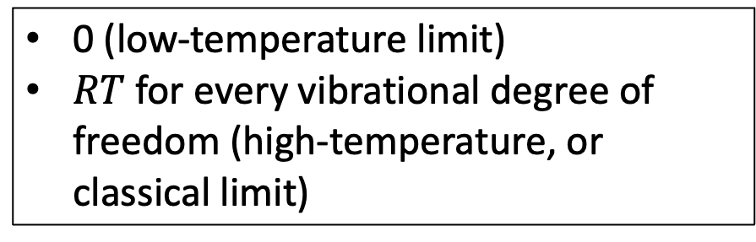
An analytical form for U(T,V)
Because three translational degrees of freedom
$$U\left(T,V\right)=\left[\frac{3}{2}RT+f_{rot}\left(T\right)+f_{vib}\left(T\right)+f_{intermol}(T,V)\right]× n$$
$0$ (ideal gas)
$−\frac{na}{V}$ for vdw gas
Generally, $≠0$ for real gases
$\frac{2}{2}RT$ (diatomic & linear molecules), or
$\frac{3}{2}RT$ (nonlinear molecules)
0 (low-temperature limit)
$RT$ for every vibrational degree of freedom (high-temperature, or classical limit)

